Slide 1
Final Presentation
Signature Authentication Pen
GZSL
Mingyang Zheng (mz2594)
Yifei Li (yl3590)
Huangfeng Shi (hs2917)
EEECS E6765 Internet if Things- Physical Data Analytics, 2017 Spring

Slide 2
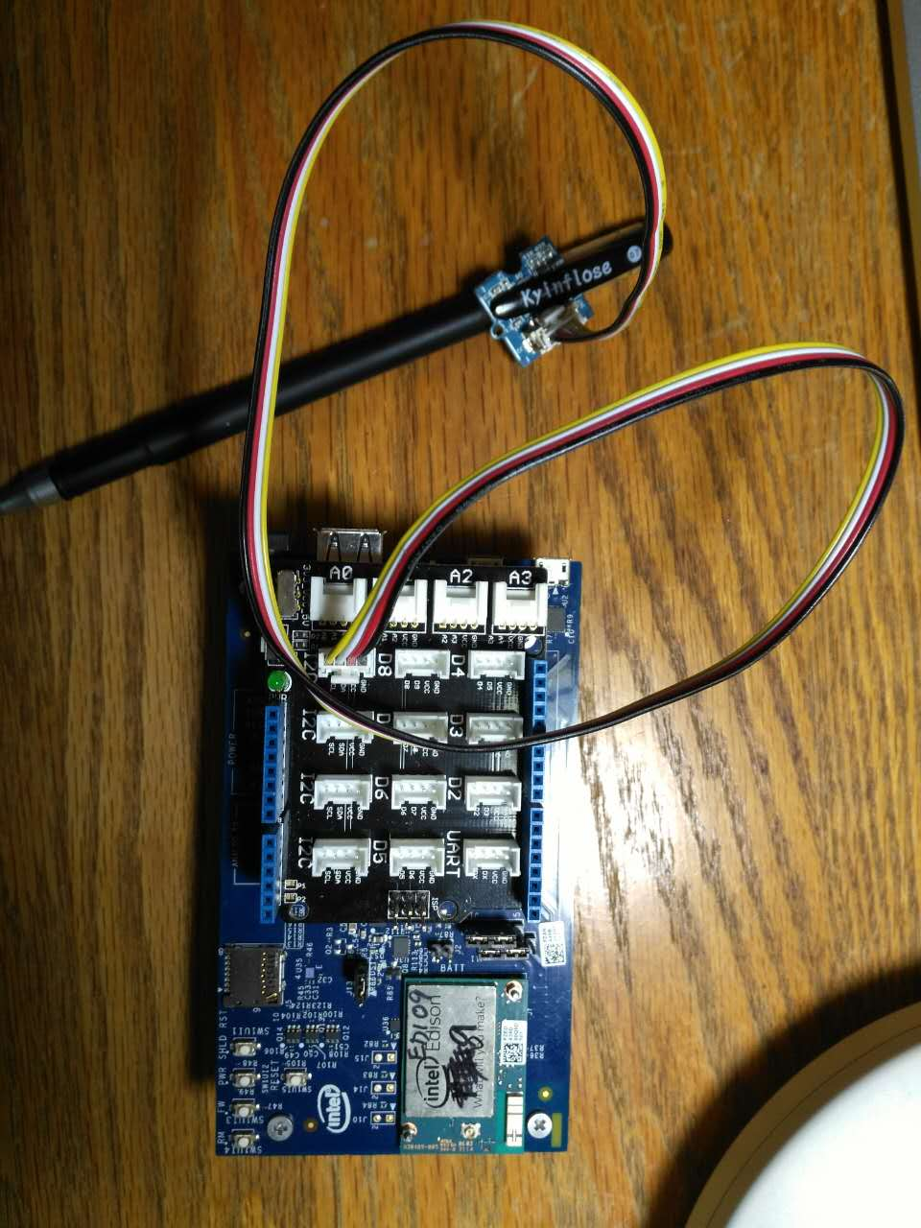
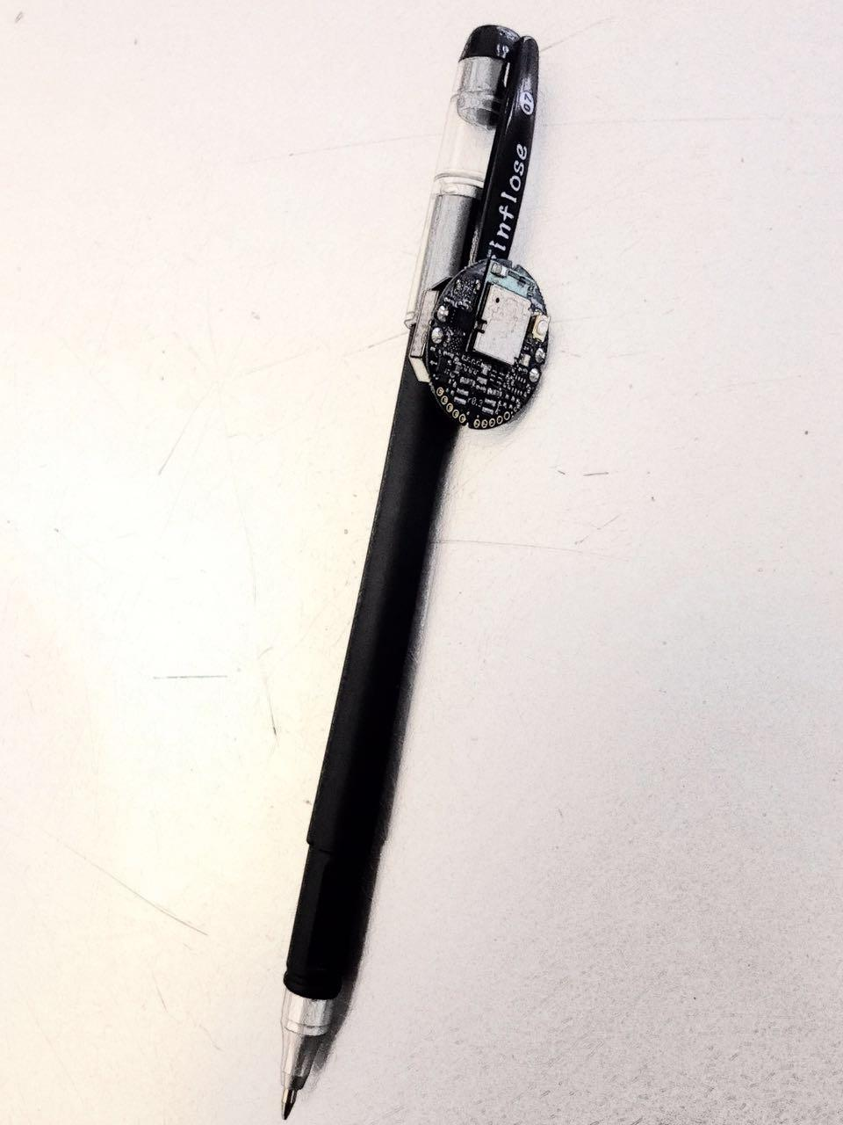
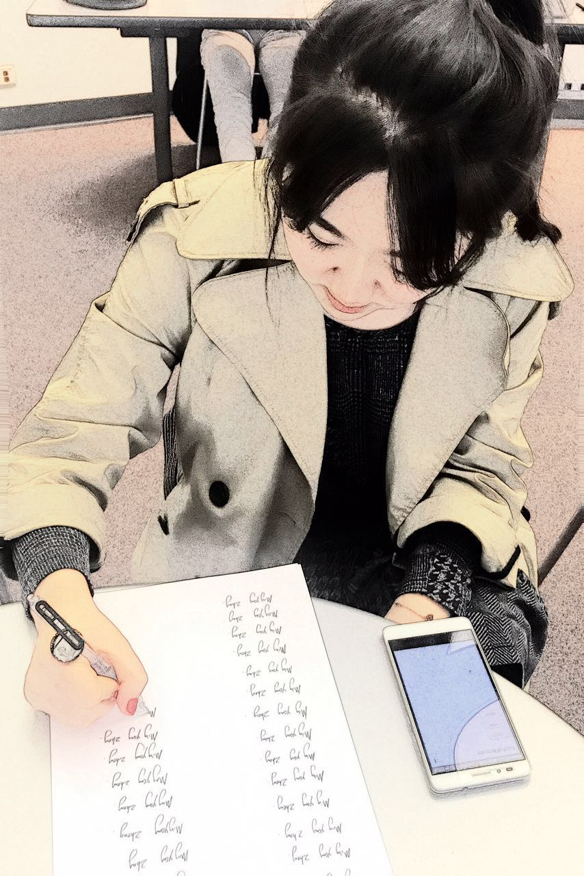
Summary Description
Signature Authentication
-Realize identity recognition by signature biometric features from users.
-Distinguish fake signature for users.
Data Collection
Embedded sensors collecting writing biometric features(Angular velocity: gyroscope, acceleration)
Set up database for different users.
Data Cleaning
(normalize, resample) original raw data
Machine Learning for Biometric Feature Model
ML algorithms (SVM / neural network/ Amazon ML) to train biometric feature model
Notes:
In this proj, a system for sa
It includes

Slide 3
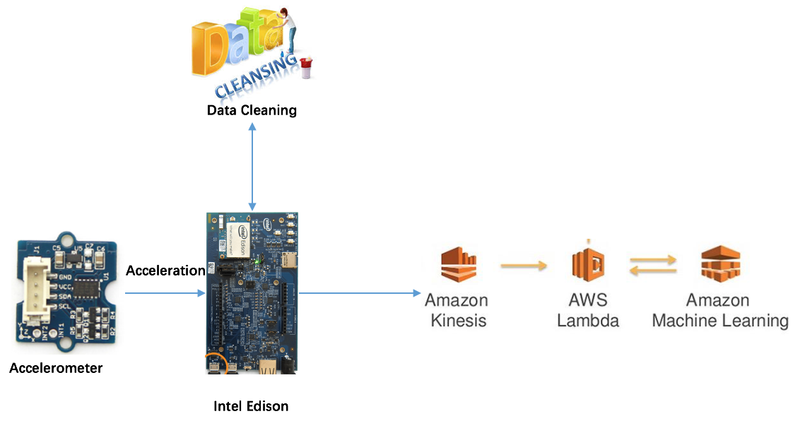
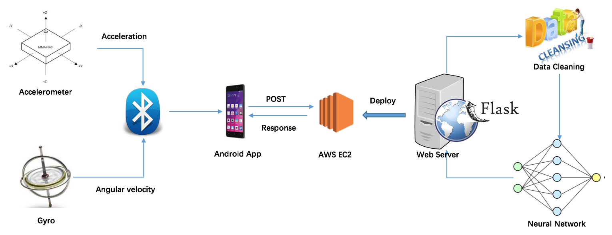
Key Results / Accomplishments
Functions:
Fake Signature Distinguish
Real Time Identity Recognition
Devices:
Wired: Intel Edison
Wireless: MetawearC

Slide 4
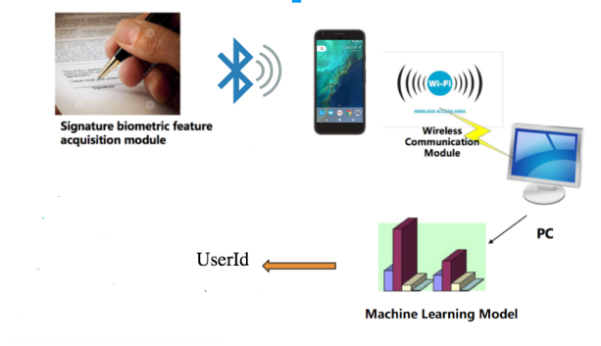
Flow Chart

Slide 5
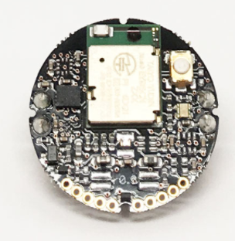
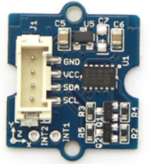
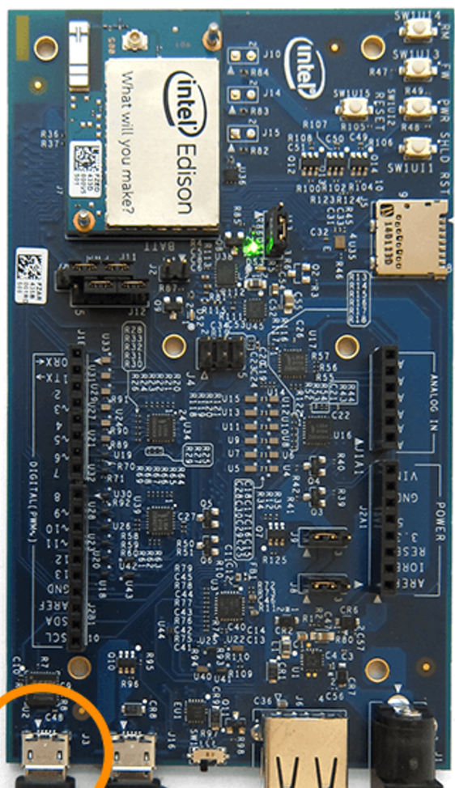
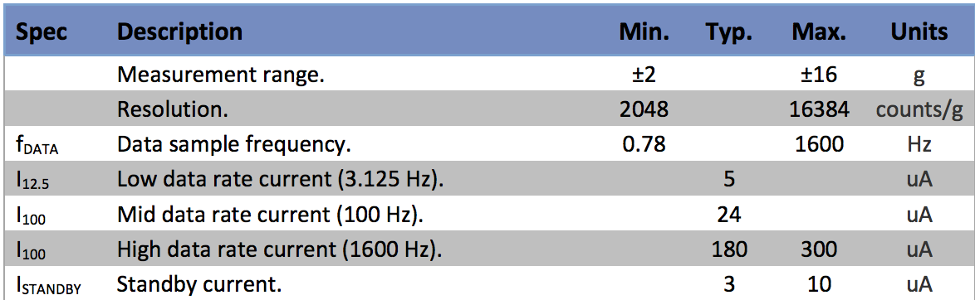
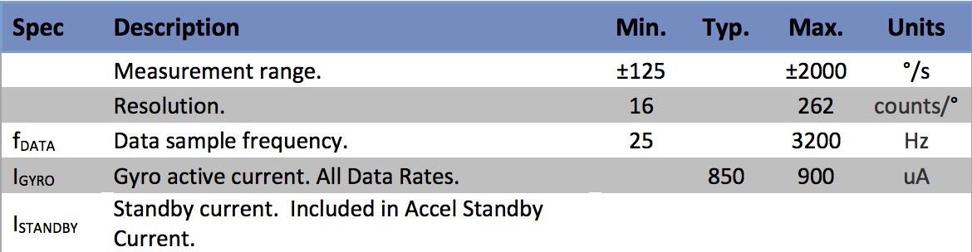
Data Collection
Acceleration:
Using MetawearC/ Grove -3-Axis Digital Accelerometer to collect real time data, which contains the accelerate value according to x-axis, y-axis and z-axis.
Angular velocity：Gyro
Using MetawearC 3-axis gyroscope to collect real time data, which contains the angular velocity according to x-axis, y-axis and z-axis.
or
+

Slide 6
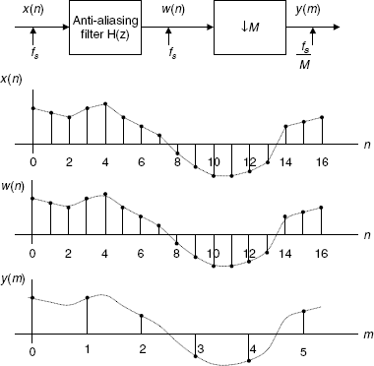
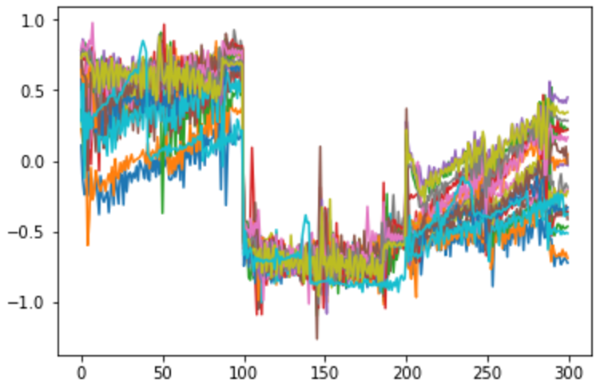
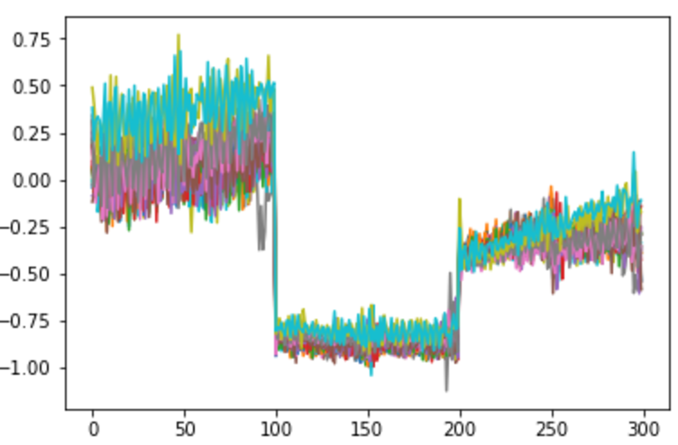
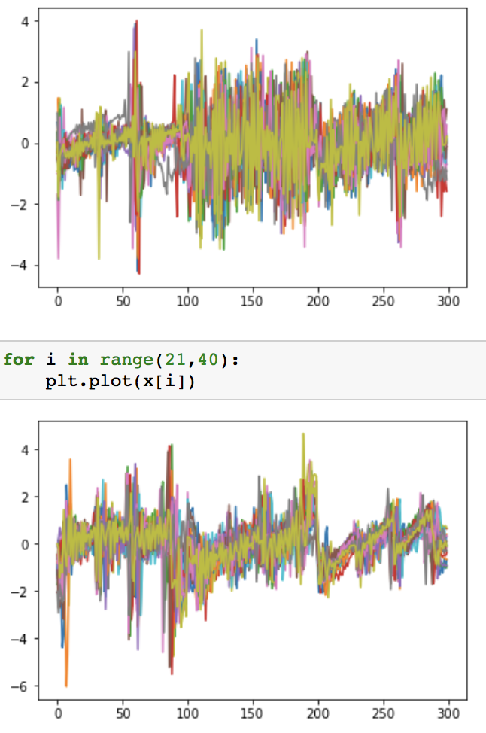
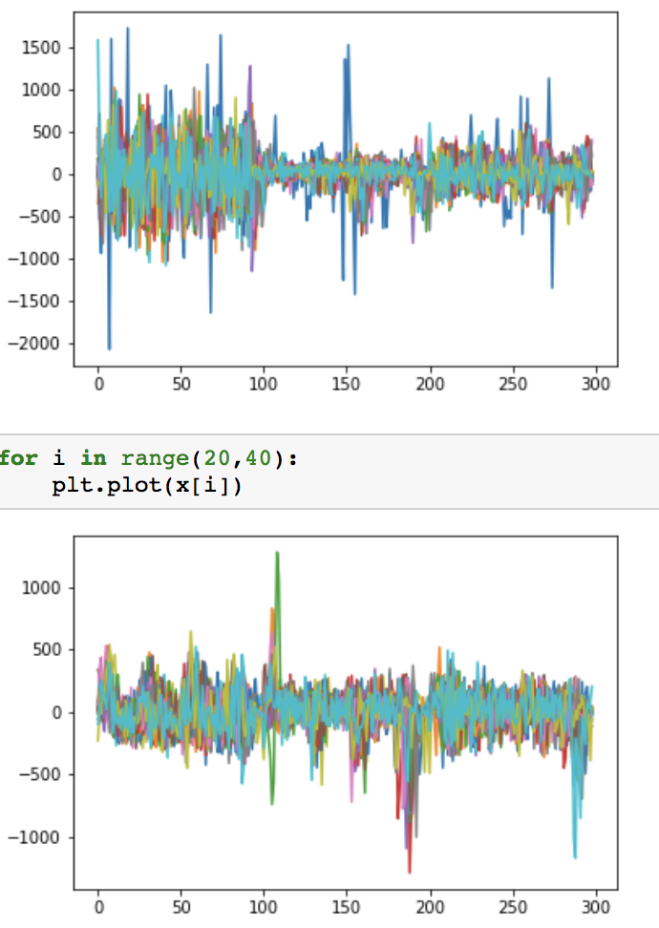
Data cleaning/data processing
Resample (Downsample/ Upsample)
- Based on FFT transformations, use Fourier-domain window that tapers the Fourier spectrum before zero-padding to alleviate ringing in the resampled values
- Results in a nice format for machine learning step and also for test step to achieve more accurate comparison analysis, preventing from the influence of writing speed.
Nomalize
- Deduct the average value from all datasets of each collection.
- Reduce errors stemmed from the difference between each starting state

Slide 7
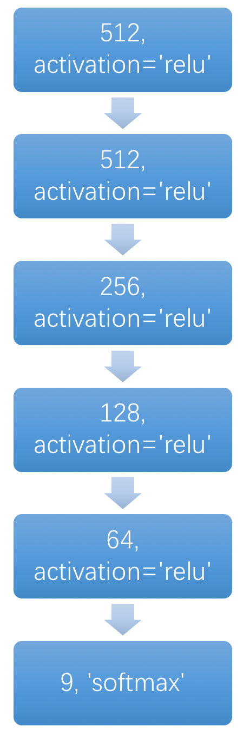
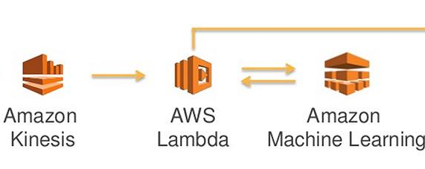
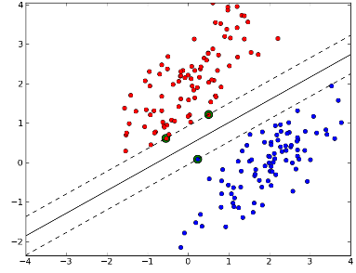
Machine Learning for Biometric Feature Modeling
Amazon ML
SVM
Neural Network

Slide 8
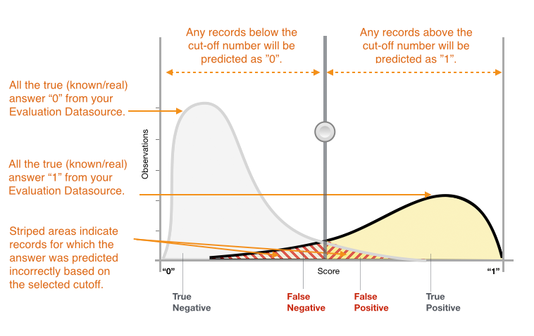
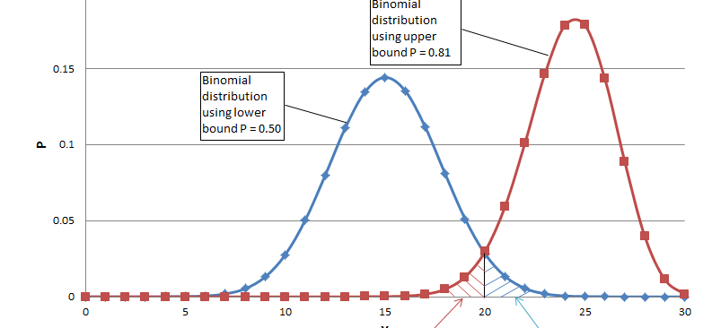
Signature Authentication (2 modes)
Real Time Identity Recognition
Identify the test data belongs to which authenticated users.
Output the exact authenticated user number.
Test user must belong to one of the users in the training classes.
Fake Signature Distinguishing
Identify whether the signature is written by the user with that name.
Output True or False.
Test user needn’t belong to the users in training dataset.

Slide 9
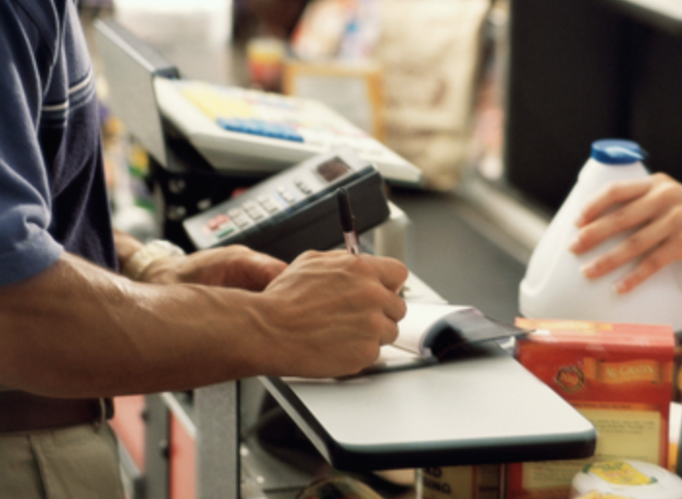

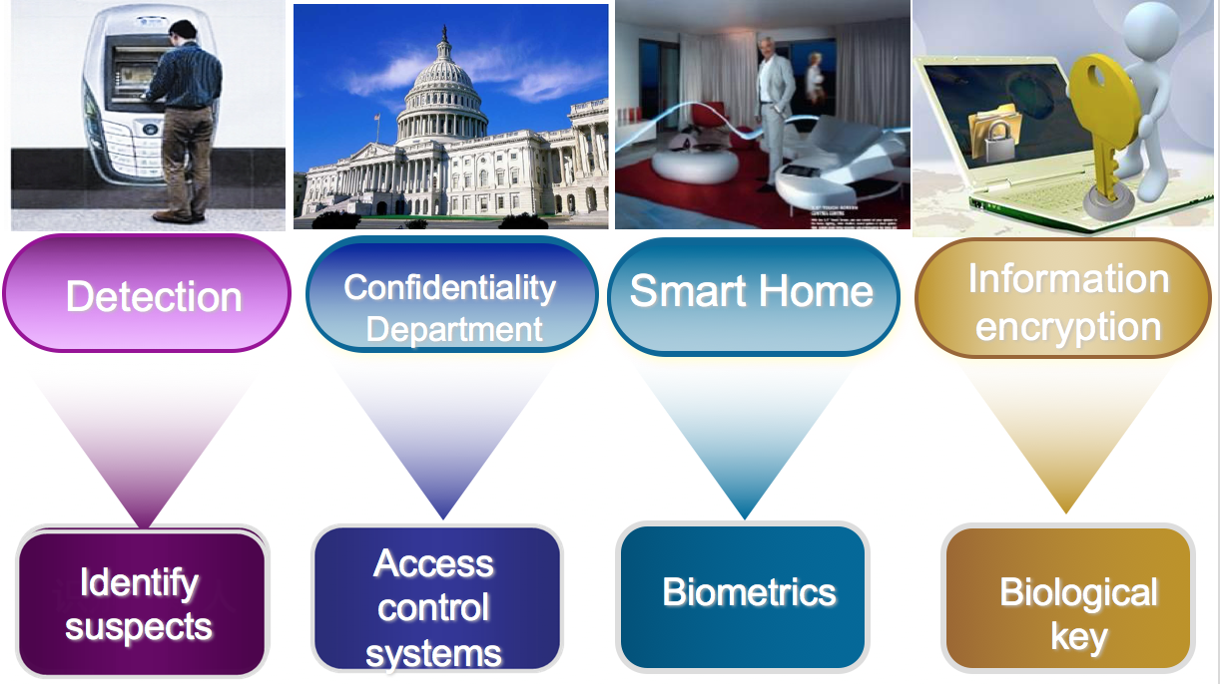
Application Scenario
Owing to its strength by recording dynamic motion, which is hard to imitate, this system can improve the accuracy and safety by identify the writing biometric features:
· Higher signature asset security demand(eg. at bank, shopping）
· Assist recognize criminals and absconder
· Smart home

Slide 10
Demo

Slide 11
Assessment of Work Planned / Work Done
Original Task | Was the task completed? | If not completed, why not? | Future Plans | Comments
Build data collecting module | yes |  | Collect more data to enrich the database
Build data transmission module | yes |  | Recognise the text according to the gesture
Build machine learning module | yes |  | Use RNN to improve the accuracy of learning

Slide 12
Assessment of Work Planned / Work Done
Original Task | Was the task completed? | If not completed, why not? | Future Plans | Comments
Realize real-time identity recognition by AWS Lambda | yes
Build display module | yes

Slide 13
Links to Reports, Web Sites, Code, Videos, ...
What | Link | Comments
Enter weebly name | http://iotcolumbia2017gzsl.weebly.com
Enter Github name | https://github.com/zmyzheng/Signature-Authentication-Pen
Enter proposal name | Signature Authentication Pen
Enter final report name | Signature Authentication Pen
Video | https://youtu.be/xxnGFsNmaTY

Slide 14
Parts Used
Group ID | Part Name | Number of Units | Cost per one unit | Total cost | Link for ordering | Why is the part needed
 | Bluetooth wireless sensor | 1 | 60 | 60 | https://mbientlab.com/product/metawearc/ | Collect data and send it to mobile device
 | Grove -3-Axis Digital Accelerometer (±16g) | 1 | 9.9 | 9.9 | https://www.seeedstudio.com/Grove-3-Axis-Digital-Accelerometer%28%C2%B116g%29-p-1156.html
 | Grove - Universal 4 Pin Buckled 50cm Cable (5 PCs Pack) | 1 | 3.9 | 3.9 | https://www.seeedstudio.com/Grove-Universal-4-Pin-Buckled-50cm-Cable-%285-PCs-Pack%29-p-928.html | Longer cable

